Slide 1

Files and Folders
For First Grade Students

Slide 2





What are Files?
A file saves information in the computer
Files can be different types

Slide 3





Different Types of Files
Documents
Pictures
Music
Videos

Slide 4

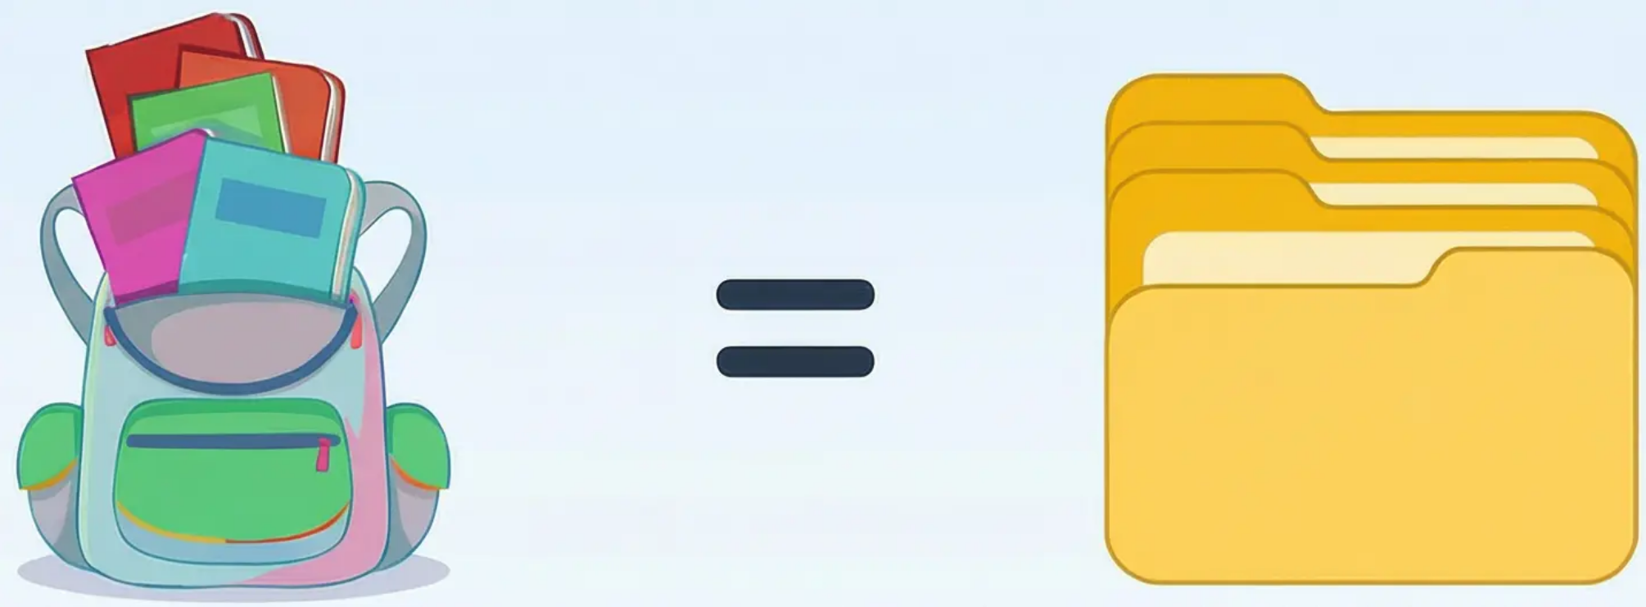
What are Folders?
Folders are like a school bag
They keep files together and organize work

Slide 5





How Folders Look on Computer
Folders have yellow icons
Nothing inside!
Empty Folder
Folder with Files
Has no files
Has different files
Look for yellow icon cards to find folders!

Slide 6

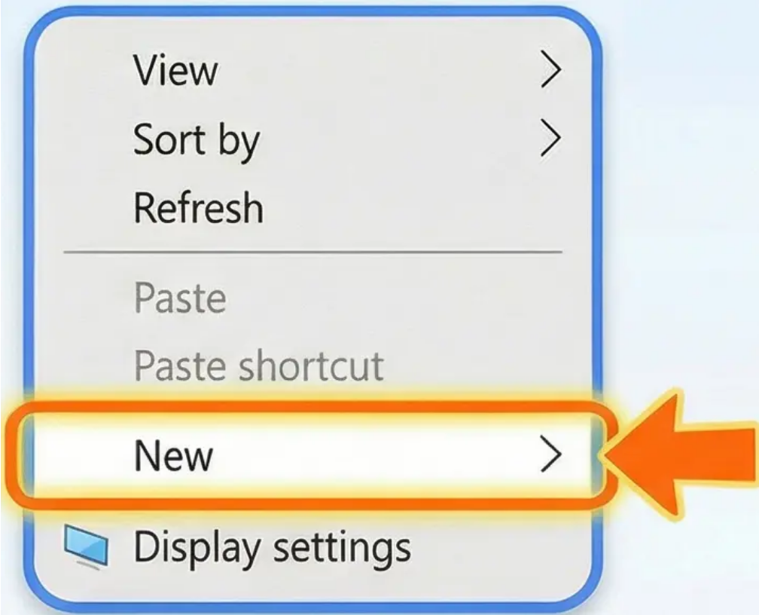
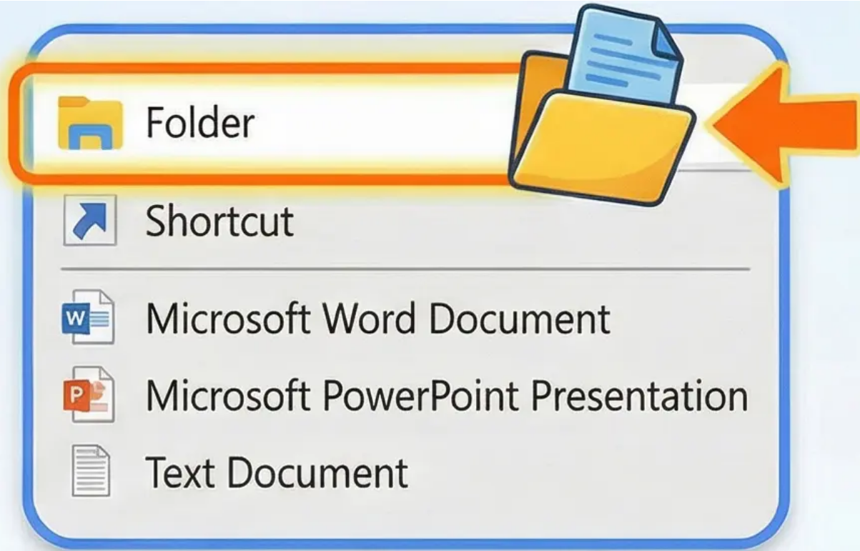


How to Create a New Folder
Step 1: Right-click on desktop
Step 2: Choose “New”
Step 3: Choose “Folder”

Slide 7
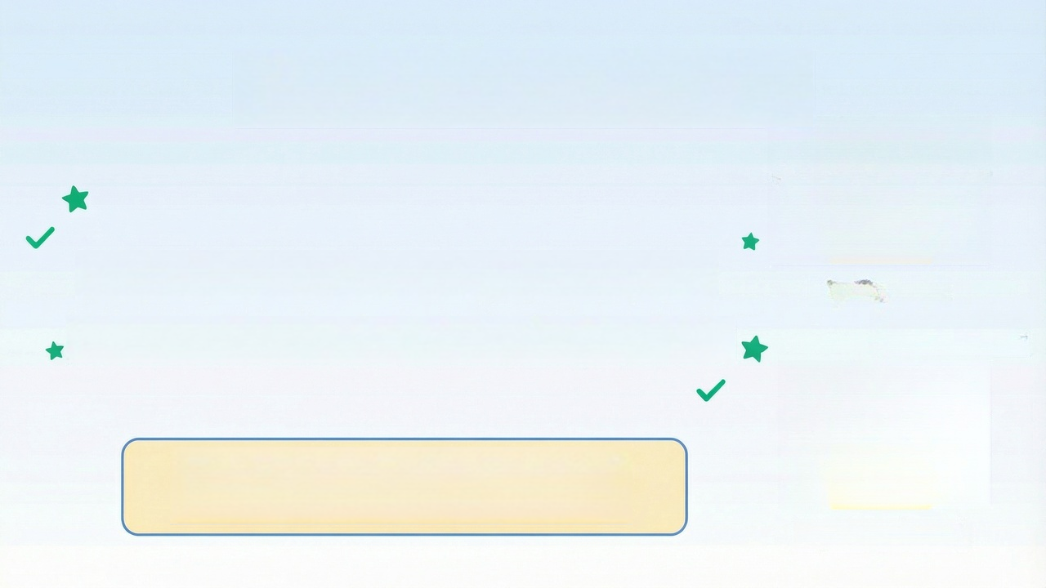
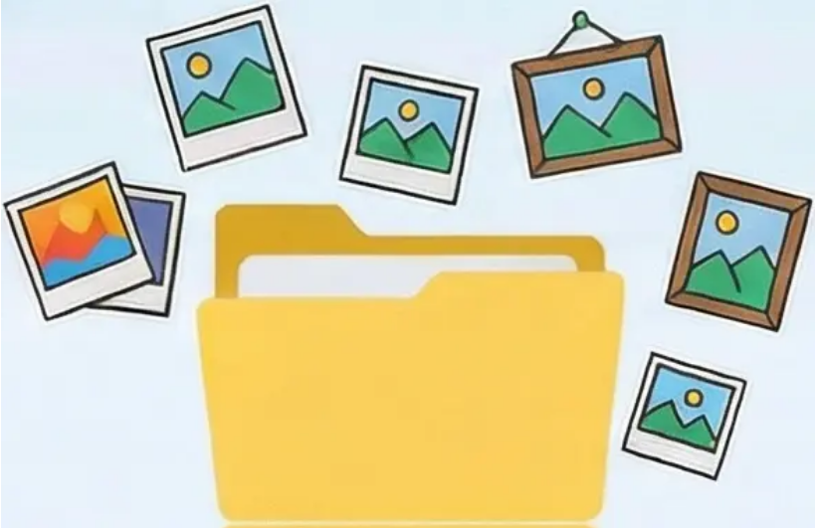

Naming the Folder
It’s important to give good names to folders so we know what’s inside easily.
My Pictures
Example:
Choose a name that tells you about the folder's content!
My Homework

Slide 8

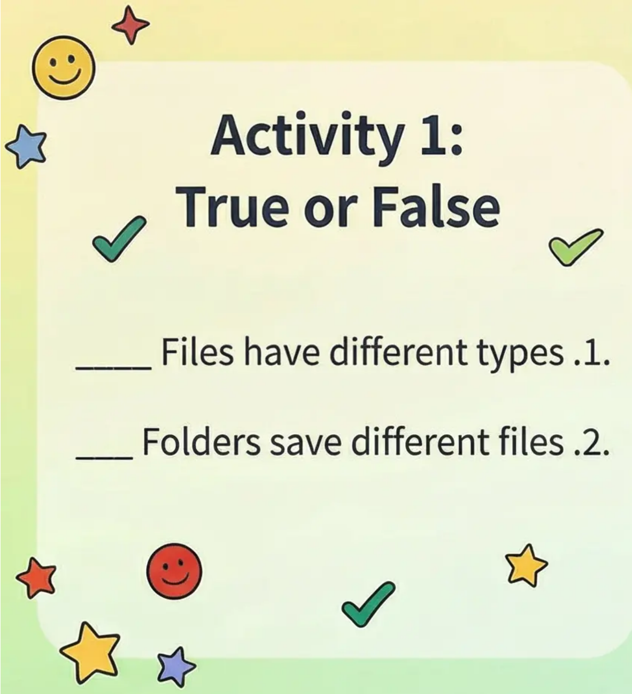
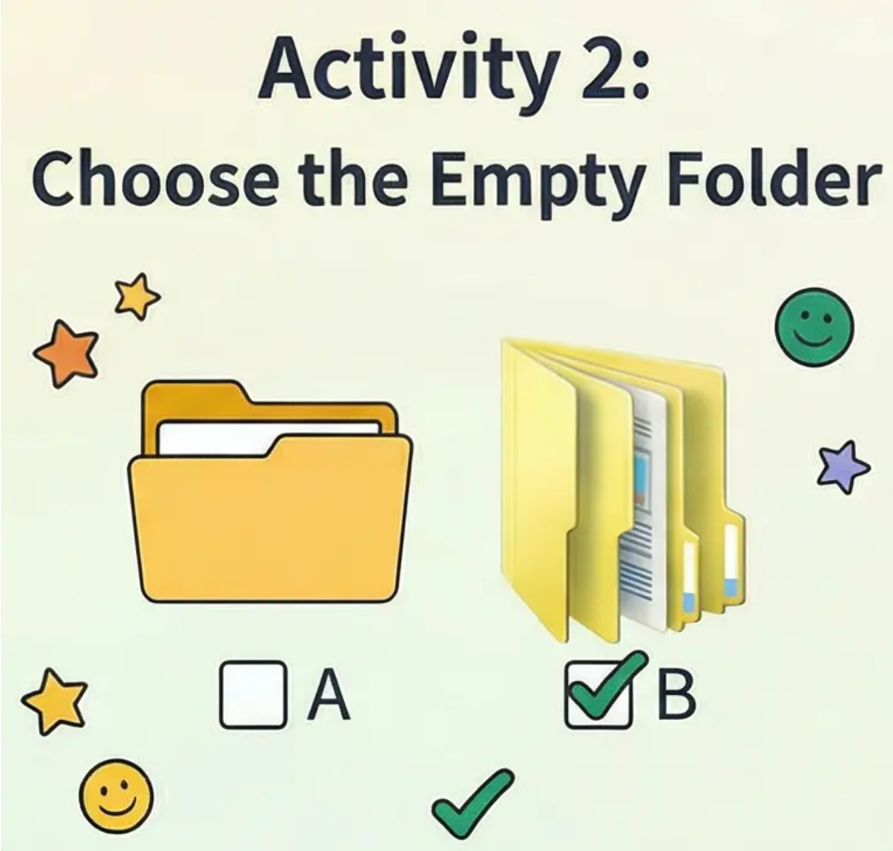
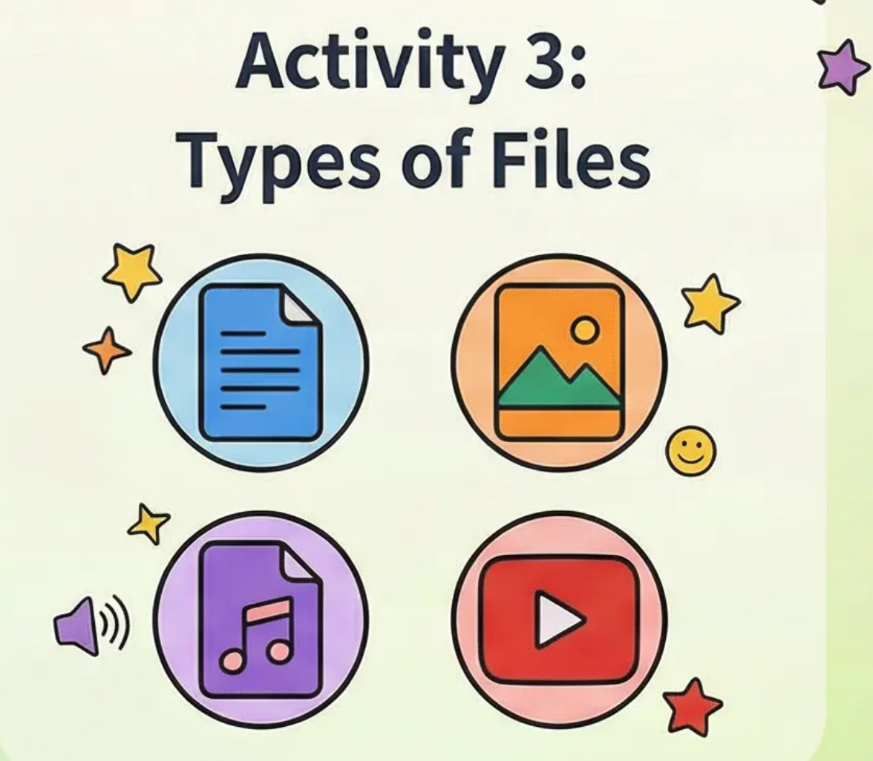
Interactive Exercises
Fun activities to practice what we learned
Well done! You learned a lot about files and folders

